Slide 1
Deep-Q Network

Slide 2
Objectives
NFQ Challenges
Experience Replay
Target Network
Better exploration strategies
Deep Q-network (DQN)
Double Q-Learning (DDQN)
Dueling Architecture
Prioritized Experience Replay (PER)
Challenges

Slide 3
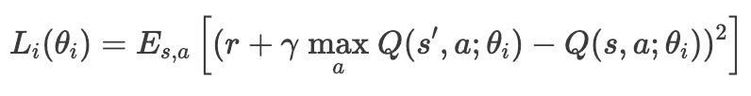
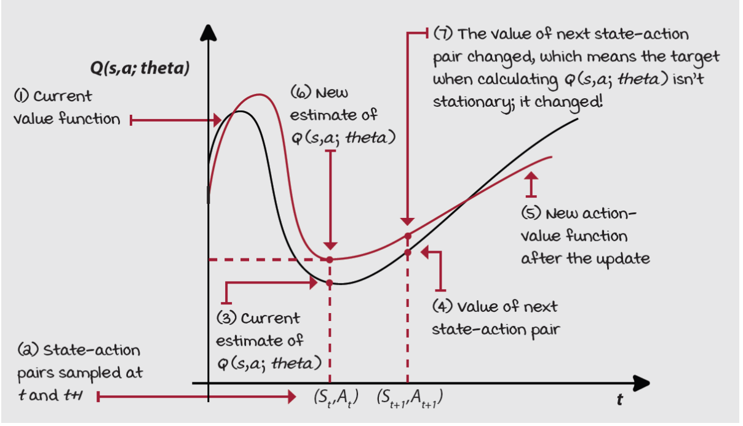
NFQ Challenges (1)
NFQ uses a non-stationary target for the learning updates
as we update the weights of the approximate Q-function, the targets also move and make our most recent update outdated.
Training becomes unstable quickly

Slide 4
NFQ Challenges (2)
We batched K experience samples, collected online, and update the NN from that batch
these samples are correlated, they come from the same trajectory and policy
later we use different batches that are also internally correlated, but different from previous batches
This means that we aren’t holding the samples independent and identically distributed (IID) assumption
optimization methods assume data samples IID distributed
We’re training on almost the exact opposite
samples are not independent
the outcome of a new state is dependent on current state
samples aren’t identically distributed
underlying data generating process, the policy, is changing over time
Optimization methods allow to relax the IID assumption to a certain degree, but we go all the way

Slide 5
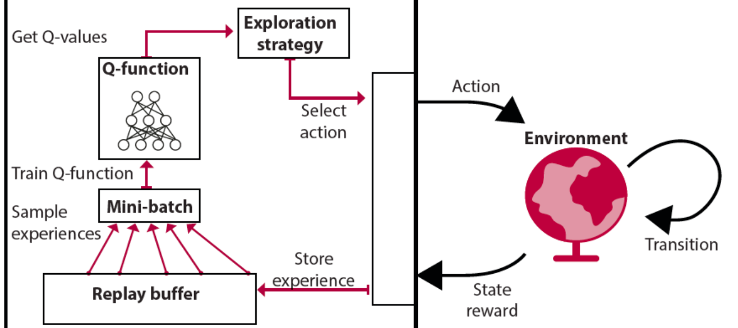
Experience Replay (1)
A data structure D to hold experience samples e_{𝑡}=(𝑆_{𝑡},𝐴_{𝑡},𝑅_{𝑡+1},𝑆_{𝑡+1}) for several steps
D=e₁,e₂,...,e_{𝑀} , 𝑀: size of the replay memory
Sampling of batches comes from a broad set of past experiences
training can use more diverse batch for performing updates
gives the impression data are IID (sampling from multiple trajectories)
agent no longer has to fit the model to the same batch for multiple iterations

Slide 6
Experience Replay (2)
A sufficiently large replay memory yields a slow-moving target
lower risk of divergence
Unfortunately, implementation Is a challenge with high-dimensional observations
replay buffers hit a hardware memory limit quickly
e.g. image-based environments (each state representation is a stack of the latest image frames)
The difference with previous equation is that we’re now obtaining experiences by sampling D, instead of using the online experiences

Slide 7
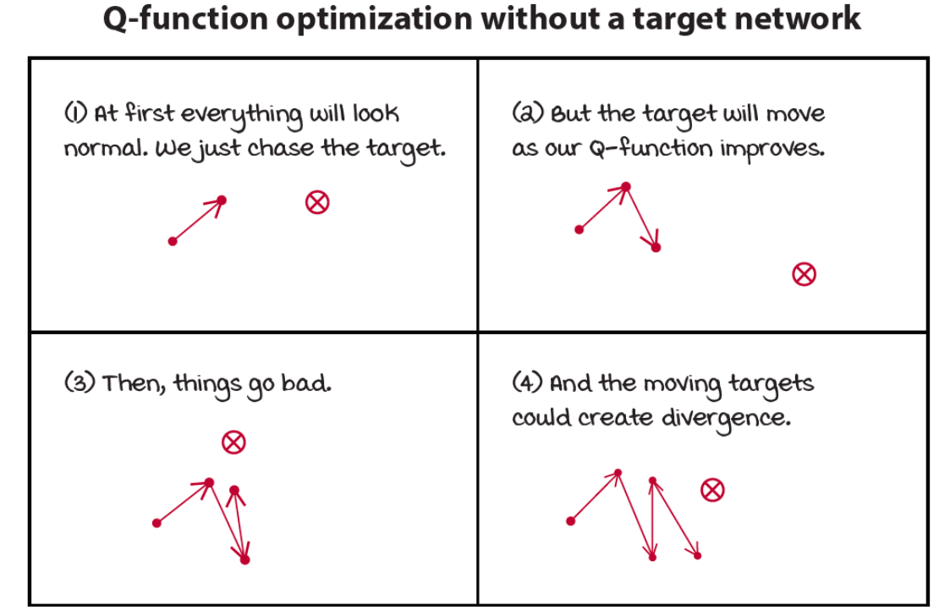
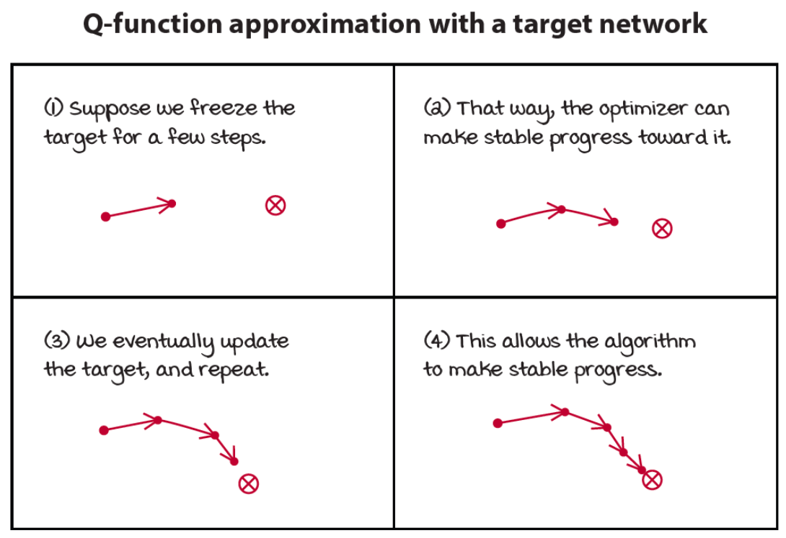
Target Network (1)
A way to make target values more stationary is to have a separate target network
We can fix it for multiple steps and reserve it for calculating more stationary targets

Slide 8
Target Network (2)
We create several small supervised learning problems presented sequentially to the agent
targets are fixed for as many steps as we fix our target network
substantially reduces the chance of divergence
The only difference with NFQ is the age of the neural network weights
notice that we don’t have two different networks
target network is a previous instance of the network that we freeze
It’s essential to balance stability and speed by tuning this hyperparameter
the gradient update has time to catch up to the target: which is stable
we slow down learning because you’re no longer training on up-to-date values

Slide 9
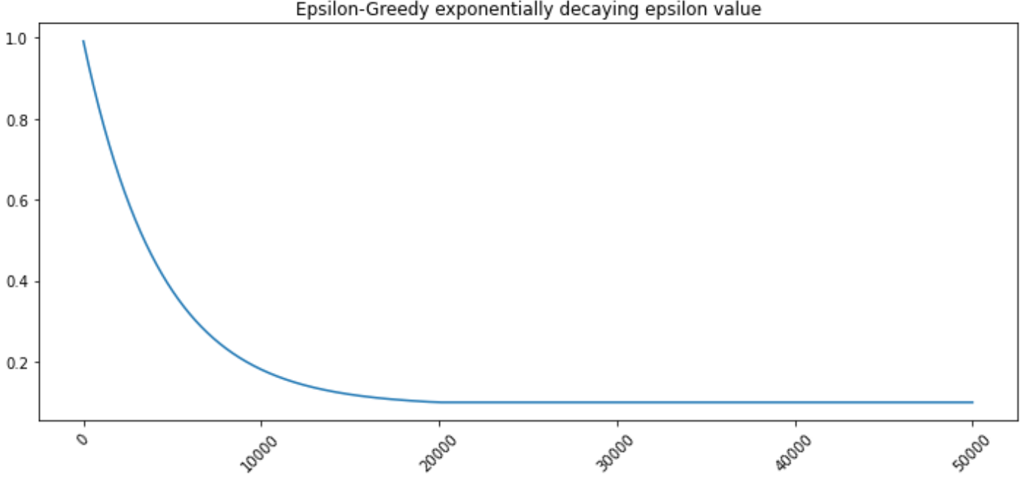
Better exploration strategies
Exploration is a vital component of RL
in NFQ, we use an epsilon-greedy exploration strategy
acting randomly with epsilon probability
However, this is not the only possible strategies to balance exploration and exploitation
decaying epsilon-greedy exploration strategy

Slide 10
Deep Q-network (DQN) (1)
One of the most popular deep RL algorithms, it started a series of research innovations that mark the history of RL
DQN claimed for the first time superhuman level performance on the Atari benchmark in which agents learned from raw pixel data from mere images
V. Mnih, et al. "Playing Atari with Deep Reinforcement Learning", NIPS 2013
use a decaying epsilon-greedy strategy, use a replay buffer, use a target network
The algorithm has the following steps:
collect experience and insert it into the replay memory
randomly sample a mini-batch from the buffer and provide it in input to both the online and the target network
use the target network to calculate the Q-values of the next state, but use the online network to calculate the Q-values of the current state
compute the loss function and update the online network
sometimes update the target network with the online network weights

Slide 11
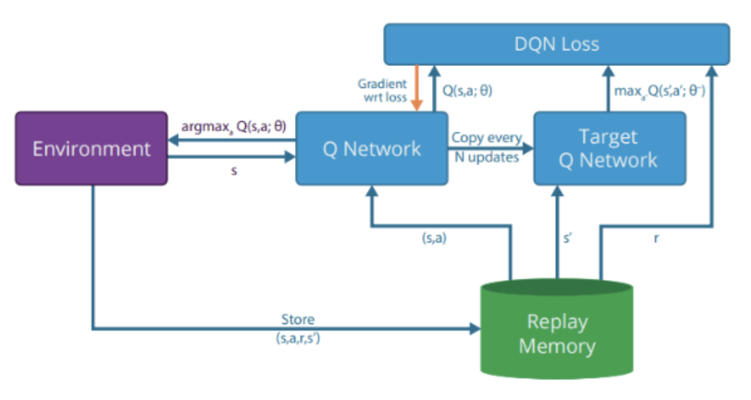
Deep Q-network (DQN) (2)
See deep-q-network.ipynb notebook

Slide 12
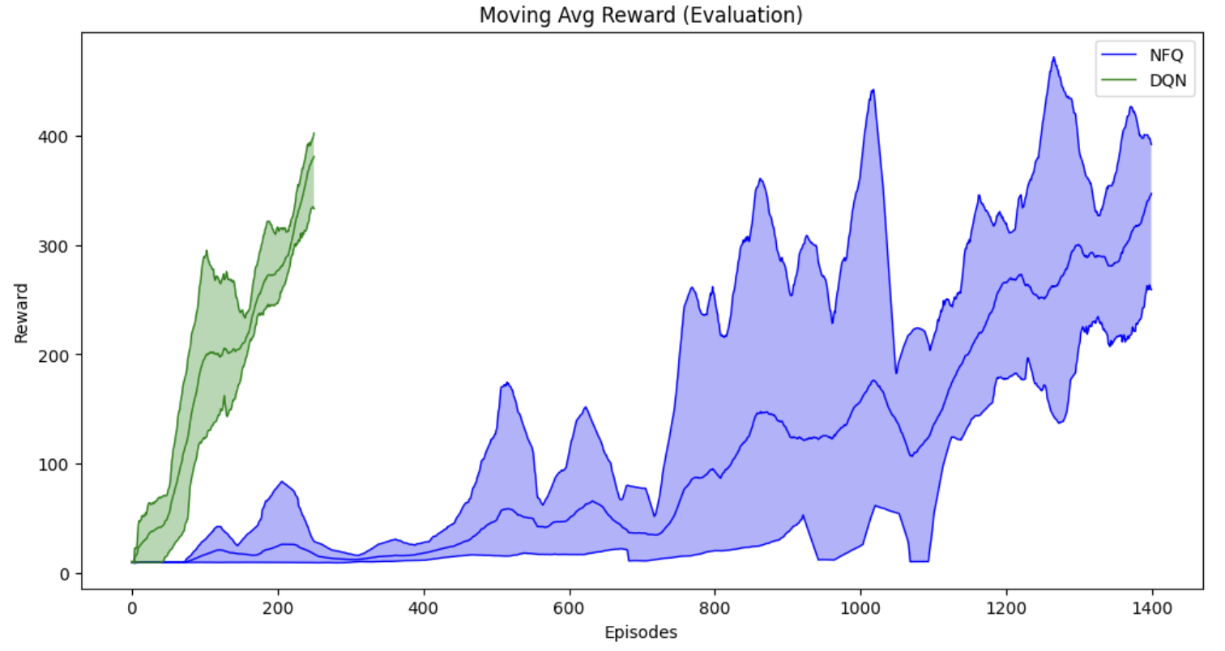
Deep Q-network (DQN) (3)
DQN takes approximately 250 episodes while NFQ takes almost 1,500 episodes to solve the cart-pole environment
DQN is more sample efficient than NFQ
NFQ is also noisier than DQN

Slide 13
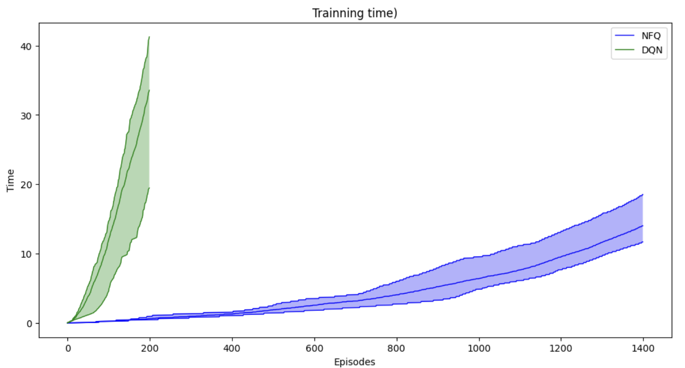
Deep Q-network (DQN) (4)
DQN takes more training time than NFQ to pass the environment.

Slide 14

Double Q-Learning (DDQN) (1)
Q-learning tends to overestimate action-value functions and DQN is no different
we’re using the same off-policy TD target with the max operator
we’re taking the max of estimated values and estimated values are often off-center
some higher than the true values, some lower, but the bottom line is that they’re off and we’re always taking the max of these values
we prefer higher values, even if they aren’t correct
We can unwrap the max operator in the target calculations:
taking the max is like asking the network ”what’s the value of the highest-valued action in state s?"
we are really asking two questions with a single question: ”which action is the highest-valued action in state s?" and then ”what’s the value of this action in state s?"
we are asking both questions to the same Q-function, which shows bias

Slide 15
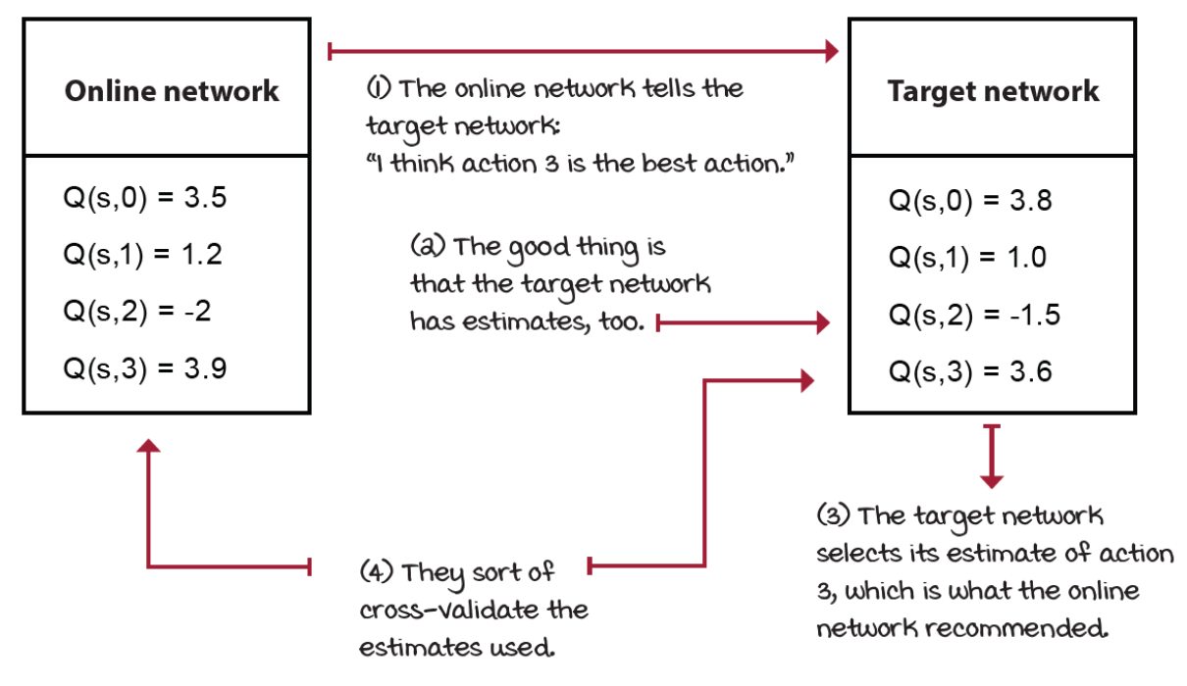
Double Q-Learning (DDQN) (2)
Idea: use the two instances of the action-value function:
See double-dqn.ipynb notebook

Slide 16


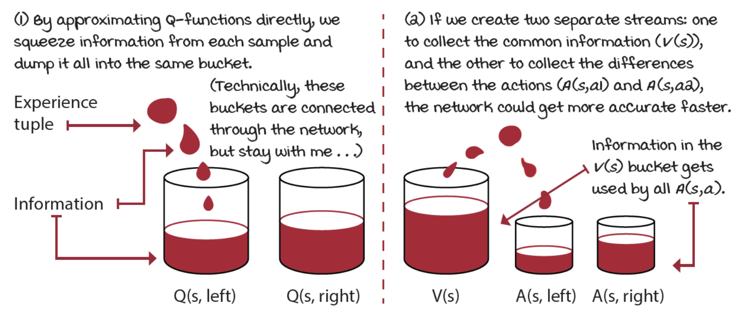
Dueling architecture (1)
We can introduce the action-advantage function A
the difference between the value of taking an action in a state and the value of choosing the policy action
=>
This means that we’re learning inefficiently, because some information is shared between the nodes of a network

Slide 17
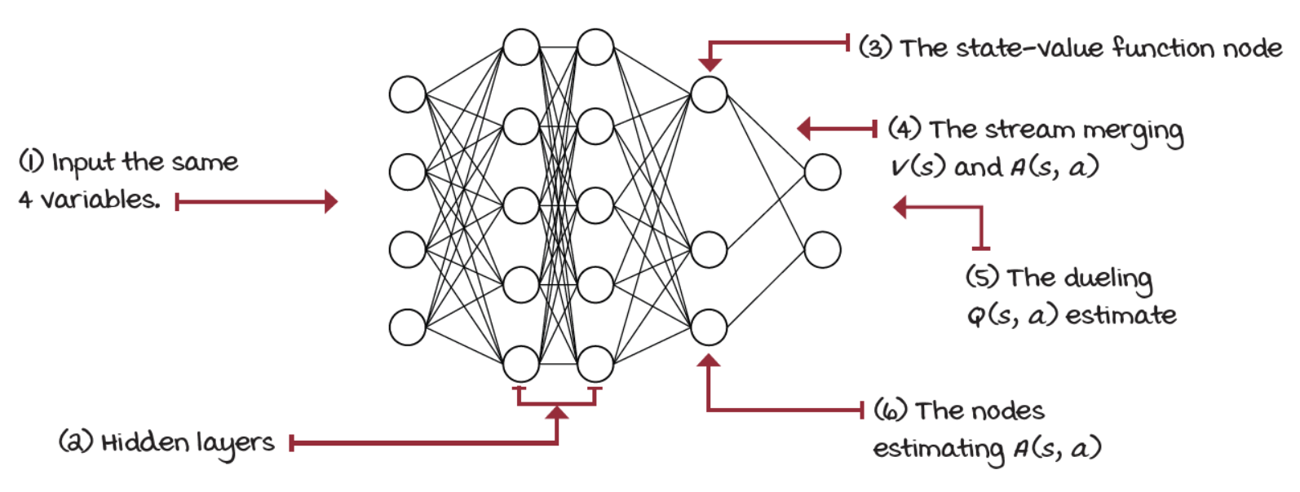

Dueling architecture (2)
We can create two separate estimators
one of the state-value function
the other of the action-advantage function
a single network sharing most of the internal nodes and layers, the layer before the output splits into two streams:
See dueling-ddqn.ipynb notebook

Slide 18

Prioritized Experience Replay (PER) (1)
We sample experience from the replay memory uniformly at random
this seems an inferior way of replaying experiences
it doesn’t feel right that the agent spends time and compute power "learning" things that have nothing to offer to the current state of the agent
What we’re looking for is to learn from experiences with unexpected value (surprising experiences)
Idea: the agent has a view of the world, he anticipates outcomes, and when the difference between expectation and reality is significant, we know he can learn something from that!
this measure of surprise is given by the TD error
We can insert experience into the replay memory as a tuple containing also to the TD error
We can pull out the top experiences from the buffer sorting by this new value

Slide 19
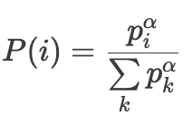
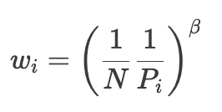

Prioritized Experience Replay (PER) (2)
Two issues:
we are calculating the TD errors twice (before inserting it into the memory, and then again when we train the network)
we’re ignoring the fact that TD errors change every time the network changes, we can’t be updating all the TD errors every time step, it’s simply not cost effective
Solution: we update the TD errors only for experiences that are used to update the network, insert new experiences with the highest magnitude TD error in the memory
We need to ensure all experiences have a chance of being replayed: we samples stochastically, not greedily:
See per-dueling-ddqn.ipynb notebook

Slide 20
Challenges
All improvements can be combined together in several different ways in order to improve the performance of the agent
the Rainbow algorithm combines all of the components we’ve seen so far and others to achieve better performance and stability.
Double DQN, Dueling DQN, Prioritized Experience Replay
Noisy Nets, Distributional DQN, and Categorical DQN
However, value-based methods are sensitive to hyperparameters
try it for yourself: change any hyperparameter, you can find more values that don’t work than values that do.
Second, value-based methods assume they interact with a Markovian environment
the state should contain all information required by the agent
this assumption dissipates
Finally, the combination of bootstrapping, off-policy learning, and function approximators are known conjointly as the deadly triad
it is known to produce divergence

